Slide 1
FDI Case Study
File created on: 5/14/2020 11:40:18 PM

Slide 2
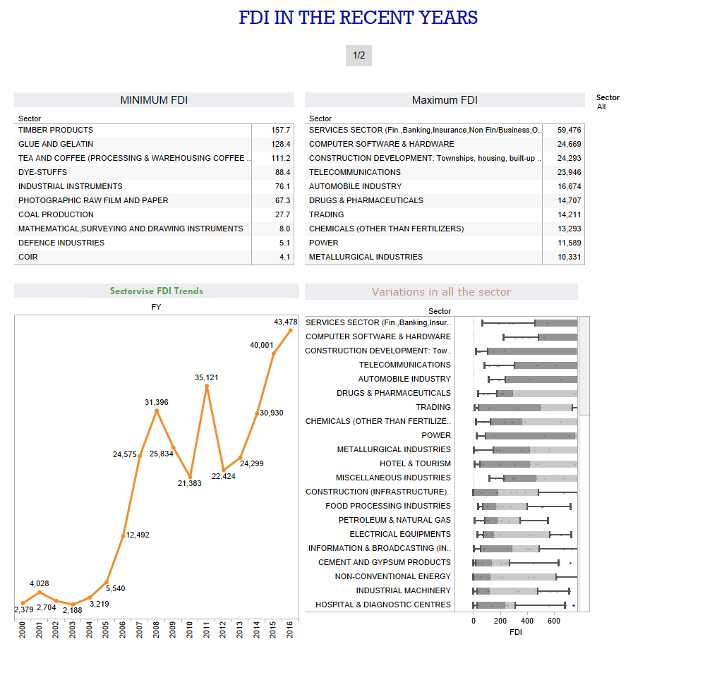

Slide 3
